Slide 1
DCA: Differential Correlation Analysis
July 2011

Slide 2
Biological motivation
Advance analysis of multiclass genomic data
In complex diseases different regulatory factors may change the level of activity of group of genes.
Disease specific regulation: gene targets may ‘become’ co-regulated only in the disease.
Differential correlation: given a pair of genes and two classes, measure the level of difference in co-regulation of the gene pair between the classes.

Slide 3
Differential correlation score
Statistical model: given two genes u and v and two classes denote as the correlation of u and v in the class C. We assume:
We can estimate the mean and variance of each distribution from the data of each class.

Slide 4
Differential correlation score
If we assume independence then
We therefore can assign a T-score for each pair of genes (the above equation is the null hypothesis).
In this process we can use any similarity\correlation function. We used Spearman correlation coefficient.

Slide 5
DCA objectives
Differential correlation pairs
Discovering disease specific regulatory cis factors(TFs, miRNA) and relevant processes
Improving classification ability

Slide 6
Part I – Enhancing classification
Given a multiclass data, perform all classes pairs analysis (also known as “one vs. one” in machine learning).
For each pair of classes we compute the DC score. For each pair of genes we keep the maximal score (‘max’ DCA) or sum over all scores (‘sum’ DCA).
We will choose the K best pairs, and for each selected pair we extract a new feature.

Slide 7
Kernel machines-1
A large group of machine learning algorithms that use a mapping of the original data into a larger space (much more features), with hope that the data is linearly separable in the new space.
These algorithms are fast since there is no need to explicitly map the data into the new space. These algorithms use only a function of the inner product in the original space to built the classifier.

Slide 8
Kernel machines-2
The intuition is that we want to find a mapping of the original data, such that the problem is easier in the new space.
The ‘kernel’ function, is the function of the inner product in the original space and can be viewed as the similarity function between samples in the new space.
k(x,y)=φ(x)•φ(y)

Slide 9
Polynomial kernel
k(x,y)=(x•y)^{d}
If d=2 then the new space is given by : x₁², x₂², x₁x_{2:}
φ
Polynomial kernel (n=2)

Slide 10
Polynomial kernel
The 2 polynomial kernel adds a feature for every binomial (e.g. pairs of features), therefore the number of new features may be very large.
Some of the new features may reduce predictive power.

Slide 11
Extracting features
To test if DCA can improve predictive power we add a feature for every pair that was selected.
Since we will add a relatively small number of features (<=80000) we can map the data explicitly without paying (to much) in computational costs.

Slide 12
Comparative analysis
We compared three SVM-based classifiers: linear kernel, 2-polynomial kernel and DCA.
We tested 12 data sets (9 gene expression-GE, 3 miRNA expression-miRNA)
We tested DCA with different number of selected edges, for GE: 40,000 and 80,000 for miRNA: 4,000 and 8,000.
For each data set and a classifier we used 3-fold cross validation, repeated 20 times.
We measured the average accuracy of each classifier.

Slide 13
Tested data sets - GE
platform | Published | #samples | #classes | Data description ( data set name)
Illumina | 2009 | 363 | 2 | Brain samples of patients with Alzheimer’s disease and controls (AD-Brain)
Affymetrix | 2008 | 234 | 7 | Blood samples from 7 auto immune diseases (AutoImmune Diseases)
Illumina | 2008 | 132 | 2 | Celiac vs. controls (Celiac)
Illumina | 2011 | 118 | 7 | Brain samples from 6 different neurodegenerative diseases and control (CNS-NDDs)
Affymetrix | 2005 | 128 | 3 | Blood samples from healthy controls and Bowel diseases: Crohn, ulcerative colitis. (IBD)
Affymetrix | 2007 | 105 | 3 | Parkinson’s disease, healthy and other diseases blood samples (PD-Blood)
Illumina | 2010 | 145 | 4 | Multiple Sclerosis- blood samples from healthy and three states of MS cases (MS-GE-Blood)
Affymetrix | 2006 | 187 | 2 | Smokers: healthy vs. lung cancer (Smokers)
Illumina | 2010 | 270 | 6 | Blood samples of patients with active tuberculosis (TB), 4 other inflammatory and infectious diseases and healthy individuals ( Tuberculosis)
Preprocessing: Filter top 3000 variation probes, merge probes by gene ID

Slide 14
Tested data sets-miRNA
platform | published | #samples | #features | #classes | Data description ( data set name)
Agilent | 2010 | 141 | 373 | 2 | Prostate samples from prostate cancer patients and healthy controls (Prostate cancer)
Illumina | 2010 | 97 | 733 | 4 | Multiple Sclerosis- blood samples from healthy and three states of MS cases (miRNA MS-Blood)
Illumina | 2010 | 145 | 734 | 5 | Samples obtained from proficient mismatch repair (pMMR) TNM stage 2|3|4 colon tumor, deficient MMR (dMMR) colon tumor, and normal colon (Colon cancer)

Slide 15
Results
Data set | linear-SVM | poly-SVM | max DCA |  | sum DCA
 |  |  | low | high | low | high
AD-Brain | 87.48 | 87.29 | 87.77 | 87.74 | 87.38 | 86.96
AutoImmune Diseases | 88.42 | 88.01 | 87.72 | 88.42 | 87.22 | 88.37
Celiac | 83.96 | 80.81 | 83.59 | 83.61 | 84.21 | 84.34
CNS-NDDs | 64.86 | 64.51 | 65.14 | 66.68 | 66.19 | 65.88
IBD | 85.65 | 84.42 | 86.68 | 87.26 | 86.81 | 87.80
PD-Blood | 47.16 | 47.70 | 50.29 | 50.22 | 49.50 | 49.37
MS-GE-Blood | 44.13 | 42.20 | 42.86 | 42.45 | 42.61 | 41.72
Smokers | 68.42 | 68.82 | 69.13 | 69.92 | 68.63 | 69.47
Tuberculosis | 84.25 | 82.34 | 84.46 | 83.57 | 82.88 | 83.28
Prostate cancer | 93.58 | 93.69 | 93.85 | 94.23 | 93.00 | 94.04
MS-miRNA-Blood | 44.70 | 44.34 | 44.09 | 44.38 | 45.69 | 42.94
Colon cancer | 71.21 | 71.61 | 72.47 | 72.52 | 72.55 | 71.49

Slide 16
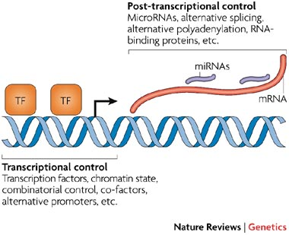
Part II –regulation in a nutshell

Slide 17
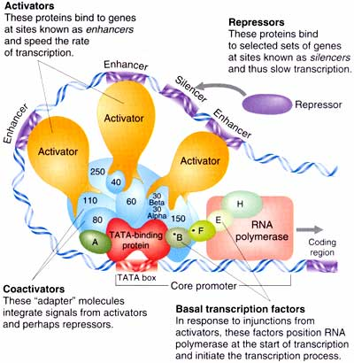
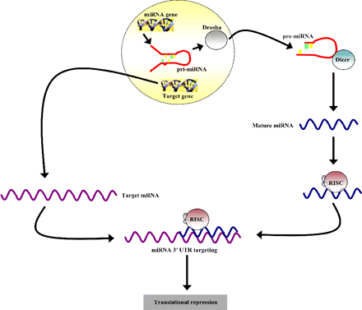
Cis regulatory factors
Transcription factors
MiRNA

Slide 18
Part II – Disease specific motif discovey
Disease (class) specific analysis.
“Reversed” analysis: instead of measuring the level of change of the regulatory genes (e.g. miRNA genes), we find differentially correlated gene modules and then look for the regulatory factor that may have caused the change.
Once modules are found, candidate cis motifs can be found using enrichment tests or sequence based motif discovery algorithms.

Slide 19
Part II – Disease specific motif discovey
In order to focus the analysis on a specific disease (a class in the data) we define two options:
Disease Specific Correlations graph (UpGraph): edges represent cases in which two genes are correlated in the tested class and are not correlated in all other classes.
Disease Specific non Correlations graph (DownGraph) : edges represent cases in which two genes are not correlated in the tested class but are correlated in all other classes.
Once we built one of the graphs we can use a graph-based modules detection algorithm.

Slide 20
DCA Flow
Input: labeled data D, a class of interest - C
Disease Specific Correlations graph
DCA
Disease Specific non-correlations graph
m1
m3
Modules discovery:
MATISSE, graph clustering
m2
m4
m5
Disease specific cis regulatory factors
Standard enrichment analysis
Transcription factors analysis: PRIMA, Amadeus
miRNA analysis: FAME, Amadeus
GO enrichments:
TANGO
Pathways analysis:
KEGG enrichments

Slide 21
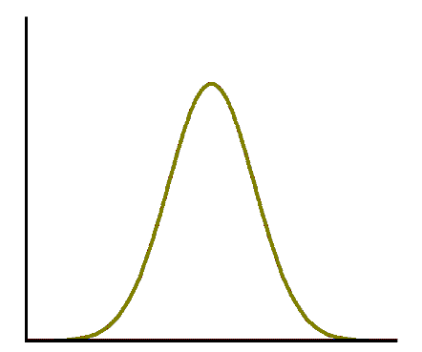
Assumptions
Given correlations distribution in one class we assume:
All correlations above the 0.9 percentage are significant.
All correlations below the 0.6 percentage are significant ‘non correlations’
Not correlated
correlated

Slide 22
Class specific cases
Edges in the specific correlations graph:
Edges in the specific non-correlations graph:

Slide 23
Finding modules
Intuition: we are looking for modules that are co-regulated or un-(co-)regulated in a specific disease.
Two options:
Co-expressed modules in the disease’s data matrix that also have large number of ‘specific correlation’ edges between.
Co-expressed modules in the data matrix of other classes that also have large number of ‘specific un-correlation’ edges between.

Slide 24
Finding modules
We propose a relaxed heuristic: find modules that are co-expressed in the GE matrix and are connected in the graph.
We set the number of selected edges to be low (< num of genes).
We used MATISSE’s heuristic to the problem:
Statistical inference of correlated pairs (mates) and un-correlated pairs (non-mates)
Assume that the probability of an edge in the network to be mates is high – beta.
Look for co-expressed modules that induce a connected sub-network.
We set MATISSE’s parameters to fit our problem:
Beta = 1 : dense modules that induce a connected component that has an “opposite” correlation signal in the other classes.
Maximal module size = 200
Use Spearman correlation as a similarity score.

Slide 25
Enrichment tests
For all tests, the background set of genes is the set of genes that remain in the data after preprocessing.
Functional enrichment analysis
GO analysis: TANGO (FDR 0.05)
KEGG analysis: hyper-geometric test (0.05 Bonferroni)
Sequence based analysis
miRNA enrichment: FAME (FDR 0.05)
Transcription factors enrichment : PRIMA (0.05 Bonferroni)

Slide 26
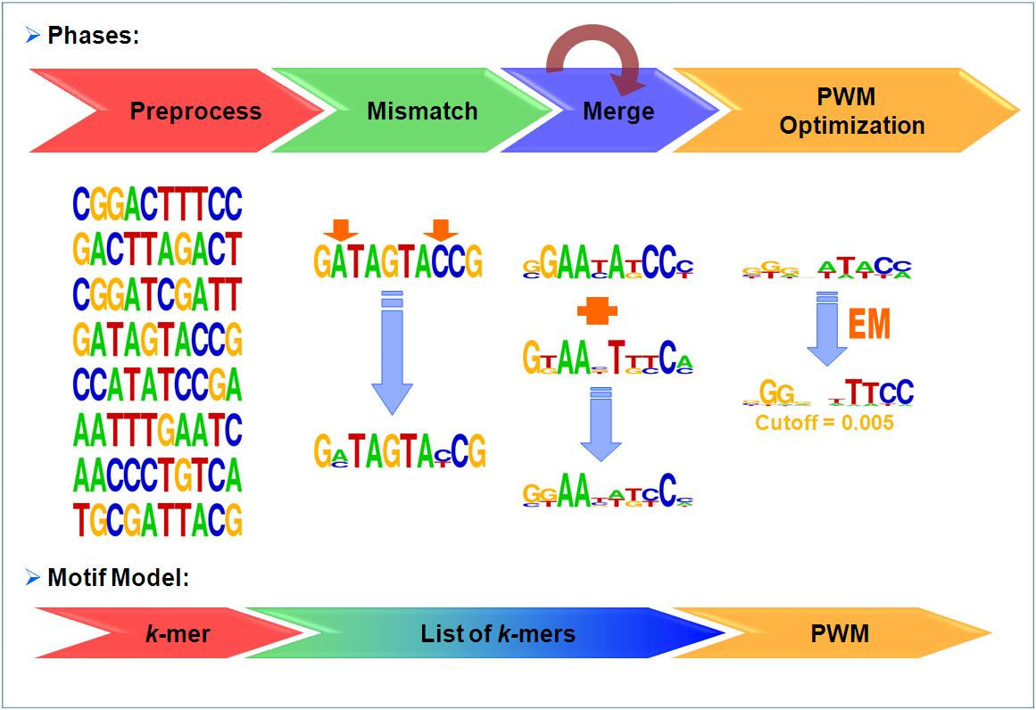
Motif discovery using Amadeus

Slide 27
Motif discovery using Amadeus
For each module discovered by MATISSE we run Amadeus with the module’s genes twice: promotors (TF) and 3’UTR (miRNA) .
By default we set the background set for statistical correction to be the set of filtered genes.
Correction for multiple testing:
Consider only the 5 best motifs in each module
Use only motifs with p-value < 1E-11
For the chosen motifs we use random sampling of gene sets (‘bootstrap’ option) and set a corrected p-value acceptance threshold of 0.05

Slide 28
Case study I: Alzheimer’s disease
Case controls study on post-mortem brain samples from a total of 363 patients (Webster et al. 2009).
The MATISSE step discovered 19 modules (12, down, 5 up) covering 1271 genes.
Overall 10 modules were significantly enriched with some functionality.
All types of advanced analysis yielded significant enrichments.

Slide 29
Comparison with standard analysis
We compared the DCA flow to a standard differential expression analysis.
We used the SAM procedure with 0.05 correction.
This procedure provided: 1361 up-regulated genes and 989 down-regulated genes.
We used these groups as modules and ran all enrichments and motif finding analyses in the DCA flow.

Slide 30
Comparison results
The standard approach performs better in discovering biological processes (i.e. standard functional analysis).
DCA performs much better in discovering of cis regulatory factors (22 vs. 0).

Slide 31
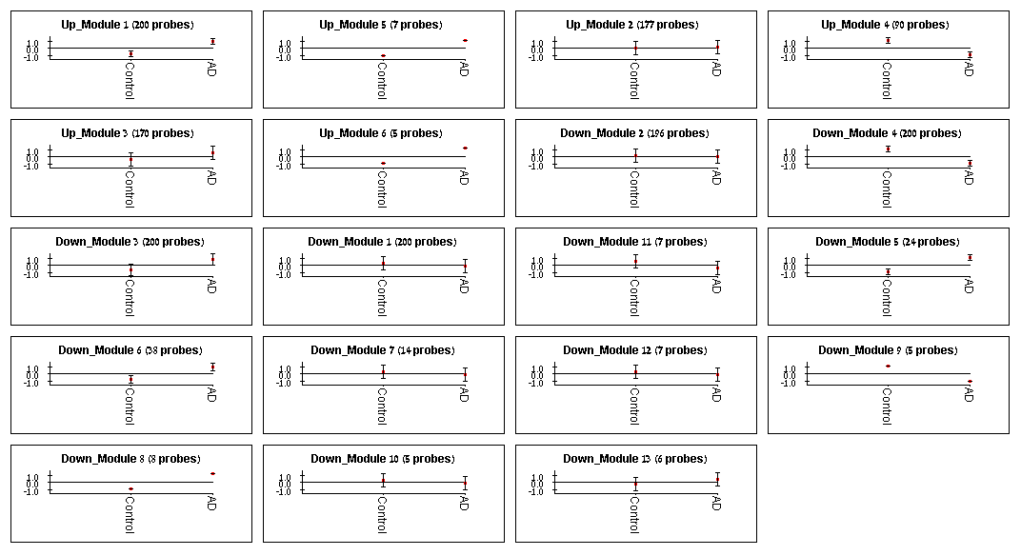
DCA modules
The MATISSE step discovered 19 modules for the AD data. This figure shows each model’s pattern averaged among the sample classes (Controls, AD). Marked modules where significantly enriched by a biological annotation.

Slide 32
Enriched miRNA
P-value | miRNA | Module
0.004 | mir-137 | Up_Module 5
0.004 | mir-590/590-3p | Up_Module 5
0.004 | mir-590/590-3p | Up_Module 6
0.004 | mir-203 | Up_Module 6
0.004 | mir-106/302 | Down_Module 5
0.009 | mir-214/761 | Down_Module 5
0.014 | mir-15/16/195/424/497 | Down_Module 5
0.017 | mir-145 | Down_Module 5
0.019 | mir-503 | Down_Module 5
0.022 | mir-377 | Down_Module 5
0.022 | mir-17-5p/20/93.mr/106/519.d | Down_Module 5
0.004 | mir-411 | Down_Module 7
0.004 | mir-376c | Down_Module 7
0.004 | mir-186 | Down_Module 7
0.004 | mir-544 | Down_Module 8
0.014 | mir-214/761 | Down_Module 8
0.004 | mir-326/330/330-5p | Down_Module 13
0.012 | mir-34a/34b-5p/34c/34c-5p/449/449abc/699 | Down_Module 13
0.014 | mir-103/107 | Down_Module 13
Results of miRNA enrichment, using the FAME algorithm. All enriched modules are relatively small. The maximal size is 24 (Down module 5)

Slide 33
Biological relevance
mir-107 has been suggested to decrease during AD progression (Wang et al. 2008, Lau and Strooper 2010)
mir103,107 were also reported to be linked with cellular migrations (Moncini et al. 2011)
Increasing levels of mir-34a where associated with AD (Cogswell et a. 2008). Loss of mir-34a occurred in neuroblastomas ()
mir-34b\c were found down-regulated in PD-brain related study (Minones-Moyano et al. 2011)
mir-17-5p/20/93.mr/106/519.d: These miRNAs where validated to target APP and therefore have potential relevance to human neurodegenerative disorders (Lau and Strooper 2010) Down regulation of these miRNAs may favor high APP levels in AD (Maes et al. 2009)
mir-15 was predicted to target APP (Cogswell et al. 2008)
mir-497 regulates neural death in mice (Yin et al. 2010)
APP that is an important factor in AD interacts with mir-106 family (Hebert et al. 2009)
SOD1 a gene related to ALS is a target of mir-377 (Milani et al. 2011)

Slide 34
Results-Amadeus
genes functions | Similar Motifs | P-value (corrected) | Motif Type | Size (#coverage) | Module
New candidate? | N/A | 9.6E-13 (0.0178) | TF | 38 (27) | Down_Module 6
SUT1 over-expression is related to sterol (anaerobic) uptake (Reiner et al. 2006) and mitochondria activity. ADR1 activate enzymes required for aerobic metabolism after glucose exhaustion (Young et al. 2003) | ADR1, ECM22, YER184C, YLR278C, SUT1, HAP1, NHP10 | 6.1E-16 (0.0034) | TF | 170 (40) | Up_Module 3
PDR1:pleiotropic drug resistance pathway (in yeast). This pathway is activated when the mitochondria is dysfunctional (Hallstrom and Moye-Rowley 2000) Sp1 abnormal expression was related to AD and tauopathies (Santpere et al. 2006) | MAZ,Churchill,ZNF515,ADR1,PDR1,MOVO-B,ZMS1,MAZR,Sp1,SP4,RNF96,STRE,ADR1,STRE,MZF1,Tra-1,Zic3 | 1.0E-14 (0.039) | TF | 200 (38) | Up_Module 1
The total number of motifs filtered before the bootstrap step: 5
This transcription factor analysis indicates cellular up-regulation of pathways for overcoming dysfunctional mitochondria.

Slide 35
Case study II – Parkinson’s disease
Blood samples from 105 patients with PD, other neurodegenerative disease and healthy controls.
The MATISSE step discovered 24 modules (13, down, 11 up) covering 1271 genes.
Overall 15 modules were significantly enriched with some functionality.
All types of advanced analysis yielded significant enrichments.

Slide 36
Comparison with standard analysis
The SAM procedure did not find any differential genes at 0.05 FDR correction level.
Without correction for multiple testing 111 genes received a p-value < 0.05 (using T-test). This group was divided to 47 down-regulated genes and 64 up-regulated genes.
We used these groups as modules and ran all enrichments and motif finding analyses in the DCA flow.

Slide 37
Comparison results
DCA performs much better in all parameters.
For discovering of cis regulatory factors: 26 vs. 4

Slide 38
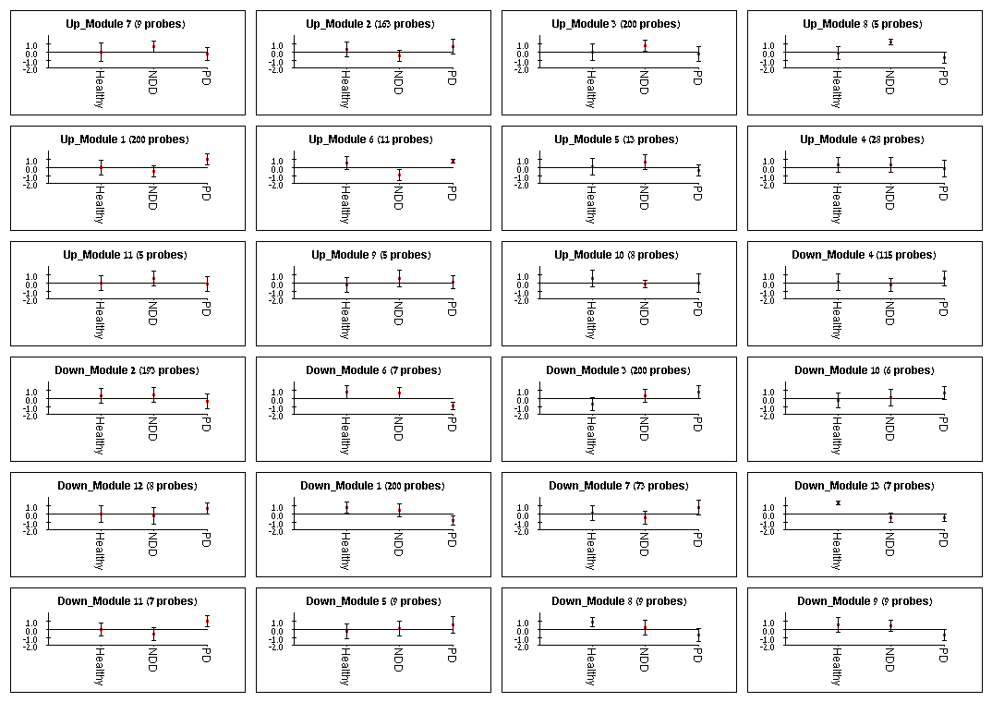
Detected Modules
The MATISSE step discovered 24 modules for the PD data. This figure shows each model’s pattern averaged among the sample classes (Healthy, neurodegenerative disorders - NDD, PD). Marked modules where significantly enriched by a biological annotation.

Slide 39
Enriched miRNA
P-value | miRNA | Module
0.004 | mir-505.hm | Up_Module 7
0.014 | mir-17-5p/20/93.mr/106/519.d | Up_Module 7
0.007 | mir-139-5p | Up_Module 11
0.009 | mir-25/32/92/92ab/363/367 | Up_Module 11
0.017 | mir-101 | Up_Module 11
0.007 | mir-30a/30a-5p/30b/30b-5p/30cde/384-5p | Up_Module 9
0.032 | mir-15/16/195/424/497 | Up_Module 9
0.014 | mir-340/340-5p | Down_Module 6
0.004 | mir-1/206 | Down_Module 10
0.004 | mir-106/302 | Down_Module 13
0.004 | mir-17-5p/20/93.mr/106/519.d | Down_Module 13
0.007 | mir-30a/30a-5p/30b/30b-5p/30cde/384-5p | Down_Module 13
0.019 | mir-182 | Down_Module 13
0.022 | mir-141/200a | Down_Module 13
0.004 | mir-140/140-5p/876-3p | Down_Module 8
0.007 | mir-17-5p/20/93.mr/106/519.d | Down_Module 8
0.012 | mir-30a/30a-5p/30b/30b-5p/30cde/384-5p | Down_Module 8
0.004 | mir-148/152 | Down_Module 9
0.004 | mir-23ab | Down_Module 9
0.019 | mir-145 | Down_Module 9
Results of miRNA enrichment, using the FAME algorithm. All enriched modules are relatively small. The maximal size is 9 (Down modules 8,9 and Up module 7)

Slide 40
Biological relevance
mir-1 and mir-30a where associated with PD in a recent blood samples study (Margis et al. 2011)
The following miRNAs where also found in the AD case study: mir-17-5p/20/93.mr/106/519.d , mir-106/302, mir-15/16/195/424/497 (p=0.011)
In a study by Mellios et al. (2008) two miRNAs were found to regulate brain-derived neurotrophic factor (BDNF) that is developmentally regulated in prefrontal cortex (PFC). Both miRNAs: miR-30a-5p and miR-195 where detected using the DCA flow.
miR-145 and miR-143 regulate smooth muscle cell fate and plasticity (Cordes et al. 2009) Mice lacking miR-145 fail to develop lesions in response to vascular injury (Xin et al. 2009). Diminished cerebrovascular function, for example a reduction in the blood flow, has been associated with or was suspected to precede neurodegeneration (Zhong et al. 2008, Bell et al. 2010).
Sittrich et al. (2010) demonstrated a central role for miR-182 in the physiological regulation of IL-2-driven helper T cell–mediated immune responses and open new therapeutic possibilities. Our results indicate down regulation of pathways related to this miRNA in PBMCs of PD patients.
mir-15 and 16 induce apoptosis (Cimminio et al. 2005)

Slide 41
Enriched transcription factors
PRIMA results on the PD data. Three transcription factors were detected after 0.05 Bonferonni correction.
P-value | Transcription Factor | Module
0.009 | M00258[ISRE] | Up_Module 6
7.12E-05 | M00453[IRF-7] | Up_Module 6
0.036 | M00062[IRF-1] | Up_Module 6
These factors are relevant to innate and adaptive immune responses. IRF-1 is related to MHC-II, a key factor of antigen presenting and is expressed in dendritic cells, B-cells and microglia. ISRE,IRF-7 and IRF-1 were linked to immune response to viral infection.

Slide 42
Results-Amadeus
Similar Motifs | P-value (corrected) | Motif Type | Size (#coverage) | Module
Zfp281, Tra-1, ASR-1, Sp1, UF1H3BETA, MOVO-B, Sp4, PCF2, DREB1B, CKROX | 1.6E-12 (0.037) | TF | 163(54) | Up_Module 2
NA | 1.3E-12 (0.04) | miRNA | 73(26) | Down_Module 7
The total number of motifs filtered before the bootstrap step: 3

Slide 43
Summary
The DCA biological analysis flow is disease specific.
By looking at disease specific pairs of differentially correlated genes, DCA extract modules that are highly enriched with cis regulatory factors. This analysis out-performs standard differential expression analysis.
The DCA flow can detect significantly enriched biological processes and pathways.
We found a significant overlap between PD and AD cases

Slide 44
References
miRNAs
Wang WX, Rajeev BW, Stromberg AJ, Ren N, Tang G, Huang Q, Rigoutsos I, Nelson PT. The expression of microRNA miR-107 decreases early in Alzheimer's disease and may accelerate disease progression through regulation of beta-site amyloid precursor protein-cleaving enzyme 1. J. Neurosci. 2008;28:1213-1223.
Pierre Laua, b and Bart de Strooper, Dysregulated microRNAs in neurodegenerative disorders Seminars in Cell & Developmental Biology Volume 21, Issue 7, September 2010, Pages 768-773
Cogswell JP, Ward J, Taylor IA, Waters M, Shi YL, Cannon B, Kelnar K, Kemppainen D, Brown C, Chen RK, Prinjha JC, Richardson AM, Saunders AD, Roses J, Richards CA. Identification of miRNA changes in Alzheimer's disease brain and CSF yields putative biomarkers and insights into disease pathways. J. Alzheimers Disease. 2008;14:27–41
Olivier C Maes,1 Howard M Chertkow,1,2 Eugenia Wang,3* and Hyman M Schipper1,2* MicroRNA: Implications for Alzheimer Disease and other Human CNS Disorders
PamelaMilani,1, 2 Stella Gagliardi,1 Emanuela Cova,1 and Cristina Cereda1 SOD1 Transcriptional and Posttranscriptional Regulation and Its Potential Implications in ALS
Moncini et al. The Role of miR-103 and miR-107 in Regulation of CDK5R1 Expression and in Cellular Migration
Elena Miñones-Moyano MicroRNA profiling of Parkinson's disease brains identifies early downregulation of miR-34b/c which modulate mitochondrial function
Regina Margisa,c, Rogério Margisb,c,∗, Carlos R.M. Riedera Identification of blood microRNAs associated to Parkinsonˇıs disease
Nikolaos Mellios1,2, Hsien-Sung Huang1,2, Anastasia Grigorenko1, Evgeny Rogaev1 and Schahram Akbarian1, A set of differentially expressed miRNAs, including miR-30a-5p, act as post-transcriptional inhibitors of BDNF in prefrontal cortex
K.R. Cordes, N.T. Sheehy, M.P. White, E.C. Berry, S.U. Morton, A.N. Muth, T.H. Lee, J.M. Miano, K.N. Ivey and D. Srivastava, miR-145 and miR-143 regulate smooth muscle cell fate and plasticity, Nature 460 (2009), pp. 705–710.
M. Xin, E.M. Small, L.B. Sutherland, X. Qi, J. McAnally, C.F. Plato, J.A. Richardson, R. Bassel-Duby and E.N. Olson, MicroRNAs miR-143 and miR-145 modulate cytoskeletal dynamics and responsiveness of smooth muscle cells to injury, Genes Dev. 23 (2009), pp. 2166–2178
Anna-Barbara Stittrich The microRNA miR-182 is induced by IL-2 and promotes clonal expansion of activated helper T lymphocytes
Rodriguez A, Vigorito E, Clare S, Warren MV, Couttet P, Soond DR, van Dongen S, Grocock RJ, Das PP, Miska EA, Vetrie D, Okkenhaug K, Enright AJ, Dougan G, Turner M, Bradley A. Requirement of bic/microRNA-155 for normal immune function. Science. 2007;316:608–611
A. Cimmino, G. A. Calin, M. Fabbri, et al., “miR-15 and miR-16 induce apoptosis by targeting BCL2,” Proceedings of the National Academy of Sciences of the United States of America, vol. 102, no. 39, pp. 13944–13949, 2005
TFs
Sonja Reiner * , Delphine Micolod , Günther Zellnig , and Roger Schneiter A Genomewide Screen Reveals a Role of Mitochondria in Anaerobic Uptake of Sterols in Yeast
Timothy C. Hallstrom and W. Scott Moye-Rowley Multiple Signals from Dysfunctional Mitochondria Activate the Pleiotropic Drug Resistance Pathway in Saccharomyces cerevisiae
G. Santpere, M. Nieto, B. Puig and I. Ferrer Abnormal Sp1 transcription factor expression in Alzheimer disease and tauopathies
Young, E.T., Dombek, K.M., Tachibana, C., and Ideker, T. (2003) Multiple pathways are co-regulated by the protein kinase Snf1 and the transcription factors Adr1 and Cat8. J Biol Chem 278: 26146–26158.
General
Zhihui Zhong1, Rashid Deane1, Zarina Ali1, Margaret Parisi1, Yuriy Shapovalov2, M Kerry O'Banion2, Konstantin Stojanovic1, Abhay Sagare1, Severine Boillee3, Don W Cleveland3 & Berislav V Zlokovic1, ALS-causing SOD1 mutants generate vascular changes prior to motor neuron degeneration. Nature Neuroscience 11, 420 - 422 (2008)
Bell, R.D. et al. Pericytes control key neurovascular functions and neuronal phenotype in the adult brain and during brain aging. Neuron 68, 409–427 (2010).

